Slide 1

Imperfections in Solids
Dr. J. Venkatramani
219-B
venkatramani@iiitdm.ac.in

Slide 2
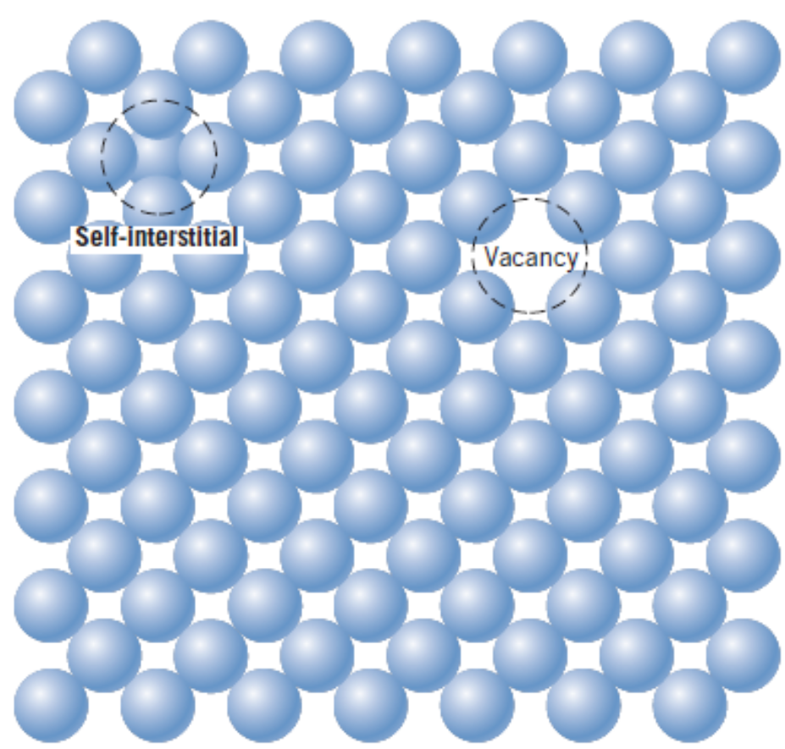
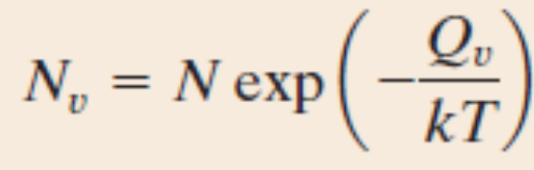
Point Defects
Vacancies
Impurities
Substitutional
Interstitial
Vacancies are driven by thermodynamics.
Factors affecting the type of impurities
  Atomic size
  Crystal structure
  Electronegativity
  Valences

Slide 3
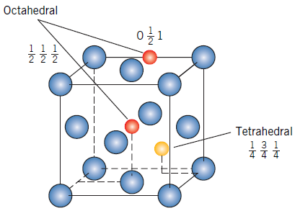
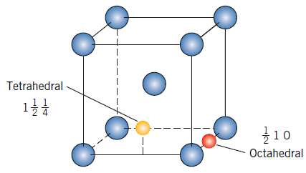
Point Defects
Substitutional solid solution. Eg: Cu and Ni, atomic radii are 1.28 A⁰ and 1.29 A⁰, electronegativities 1.9 and 1.8.
Interstitial: Iron and Carbon.
For FCC metals, potential interstitial sites are located at the mid–point of the unit cell edge.
For BCC metals, potential interstitial sites are located at the (0 ½ ¼) points on {1 0 0} planes.

Slide 4
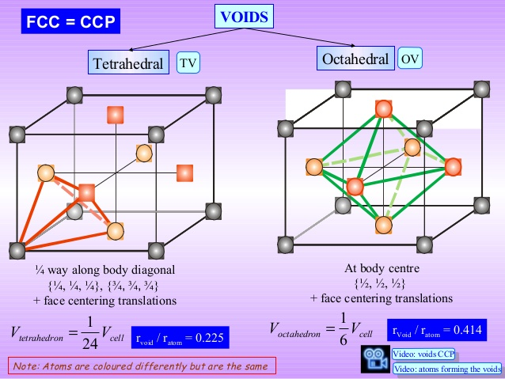

Slide 5
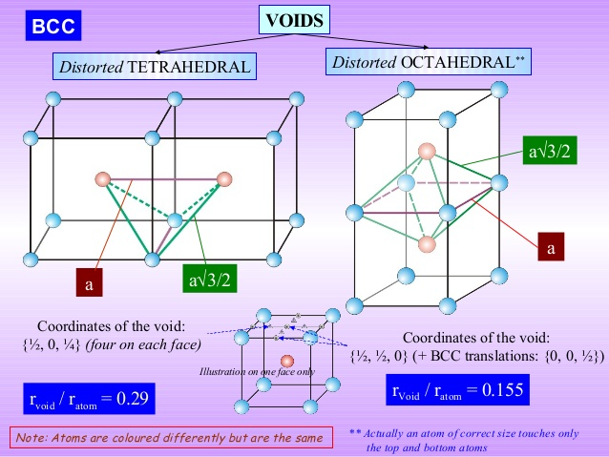

Slide 6
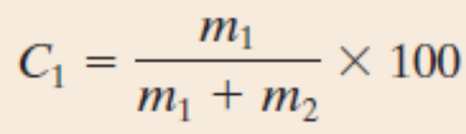
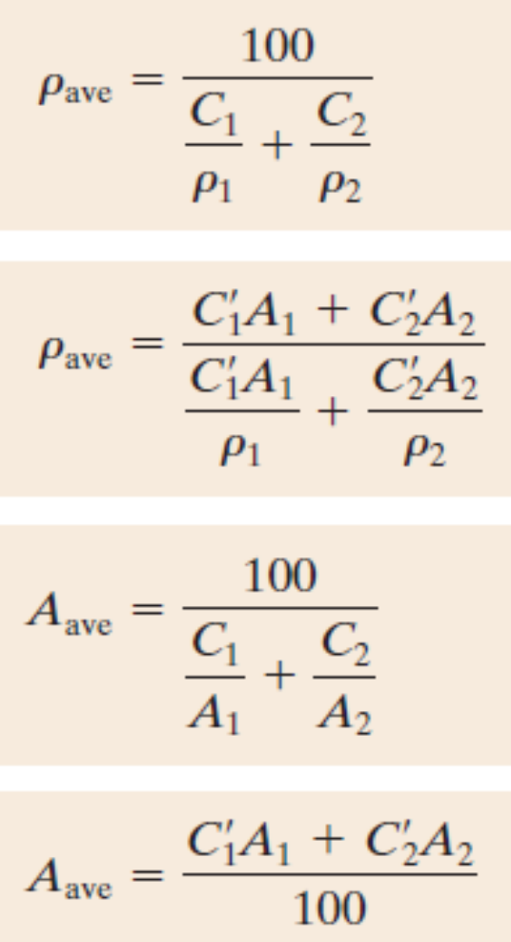
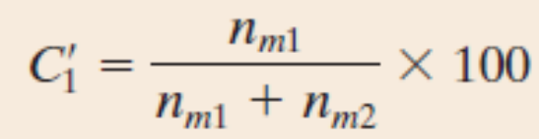
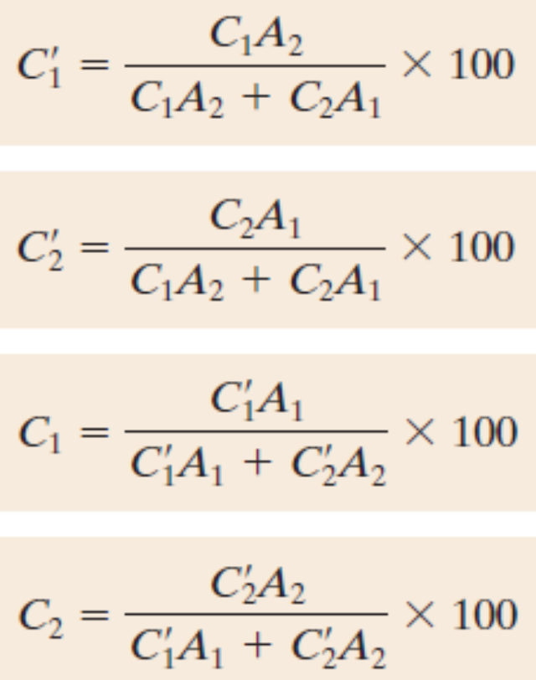
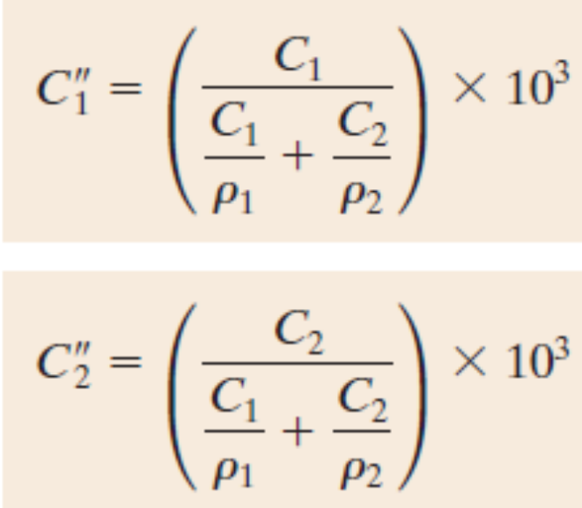
Specifying Composition of a Solid Solution
Weight percent:
Atom Percent:
Concentrations in kg/m³
Density and Atomic weight of the alloy

Slide 7
Problem
Calculate the number of vacancies per cubic meter in gold (Au) at 900⁰C. The energy for vacancy formation is 0.98 eV/atom. Furthermore, the density and atomic weight for Au are 18.63 g/cm³ (at 900⁰C) and 196.9 g/mol, respectively.

Slide 8
Class Assignment – 1 (Open Note Book/Text Book)
Sketch within a cubic unit cell (212) plane.
Can c/a be less than 1.633 in a Hexagonal Crystal Structure? Draw how the Hexagonal unit cell with c/a < 1.633 will look like.
What is the packing factor of a Hexagonal unit cell with c/a = 1.5?
Derive the planar density of (0001) plane in a HCP unit cell with c/a = 1.633.

Slide 9
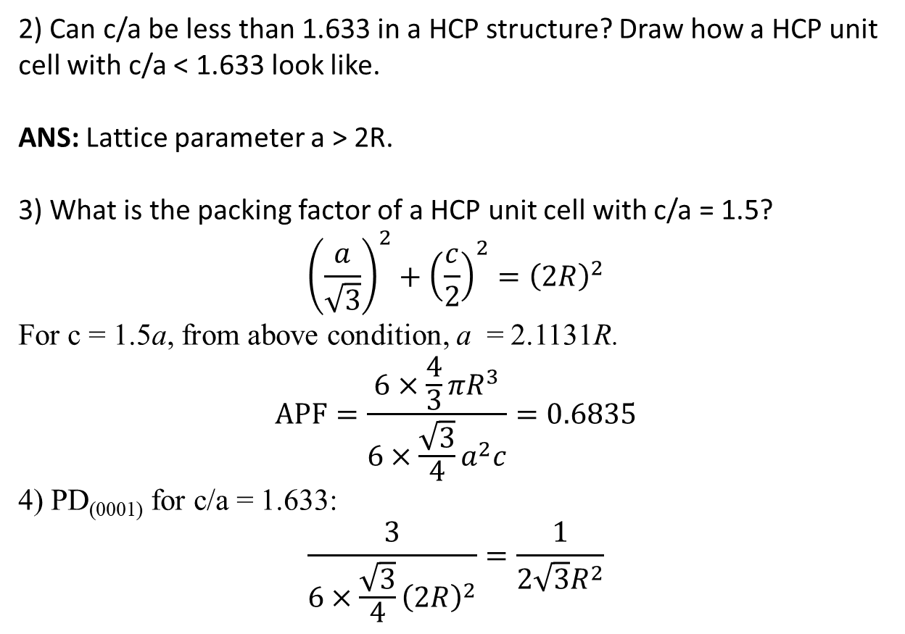
Class Assignment – 1: Solutions
1) Sketch within a cubic unit cell (212) plane.
2) Can c/a be less than 1.633 in a HCP structure? Draw how a HCP unit cell with c/a < 1.633 look like.
ANS: Lattice parameter a > 2R.
3) What is the packing factor of a HCP unit cell with c/a = 1.5?
$${\left(\frac{a}{\sqrt{3}}\right)}^{2}+{\left(\frac{c}{2}\right)}^{2}={\left(2R\right)}^{2}$$
For c = 1.5a, from above condition, a = 2.1131R.
$$APF=\frac{6×\frac{4}{3}πR^{3}}{6×\frac{\sqrt{3}}{4}a^{2}c}=0.6835$$
4) PD₍₀₀₀₁₎ for c/a = 1.633:
$$\frac{3}{6×\frac{\sqrt{3}}{4}{\left(2R\right)}^{2}}=\frac{1}{{2\sqrt{3}R}^{2}}$$

Slide 10
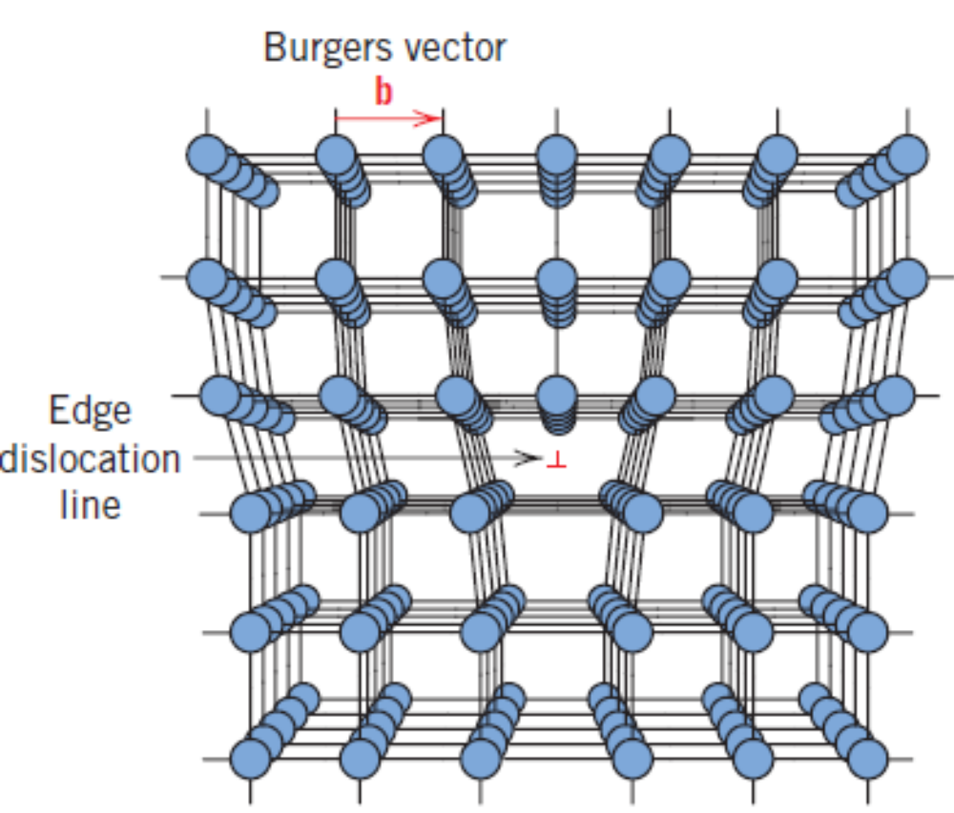
Line Defects – Edge Dislocation
Points to note:
Burger’s vector
Dislocation line
Dislocation motion

Slide 11
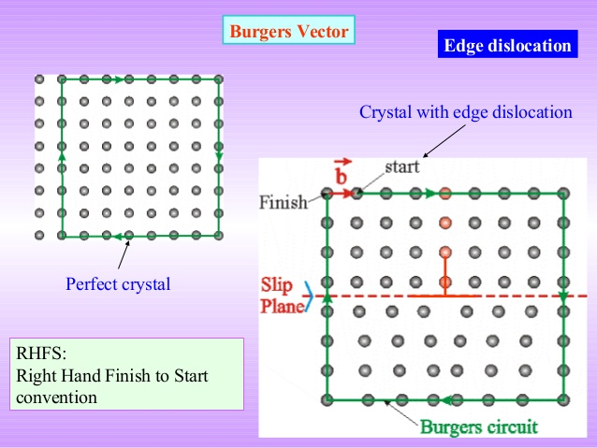
Line Defects – Edge Dislocation
Points to note:
Burger’s vector
Dislocation line
Dislocation motion

Slide 12
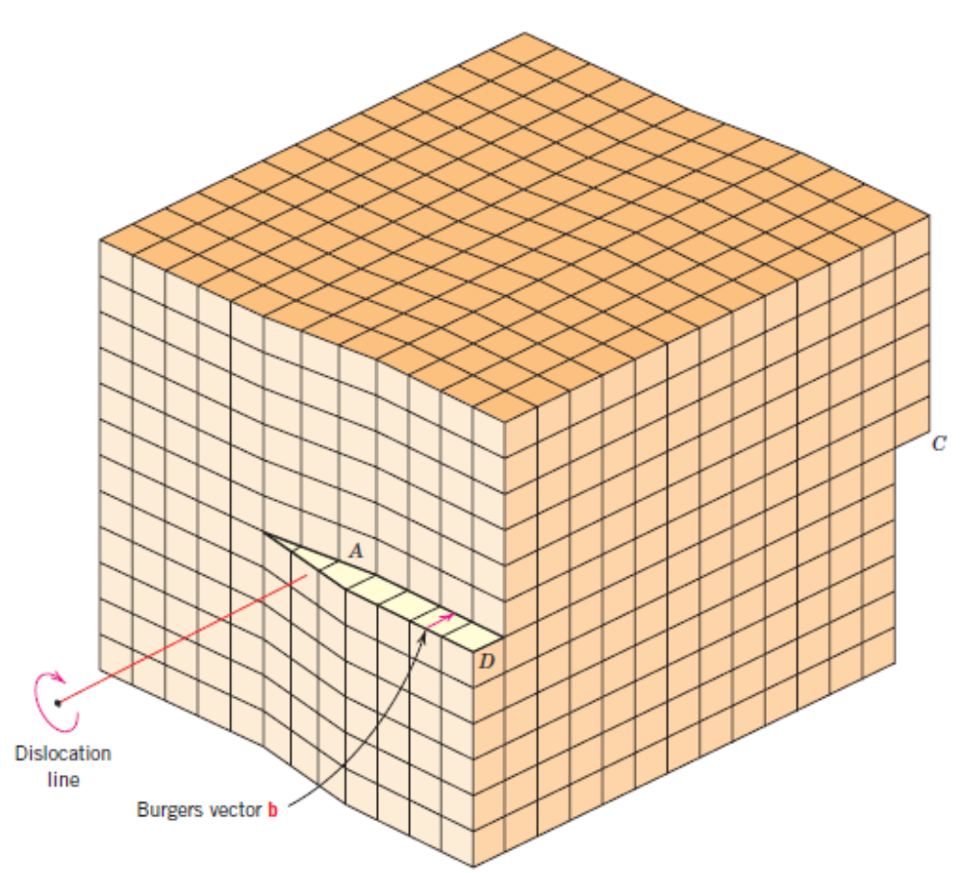
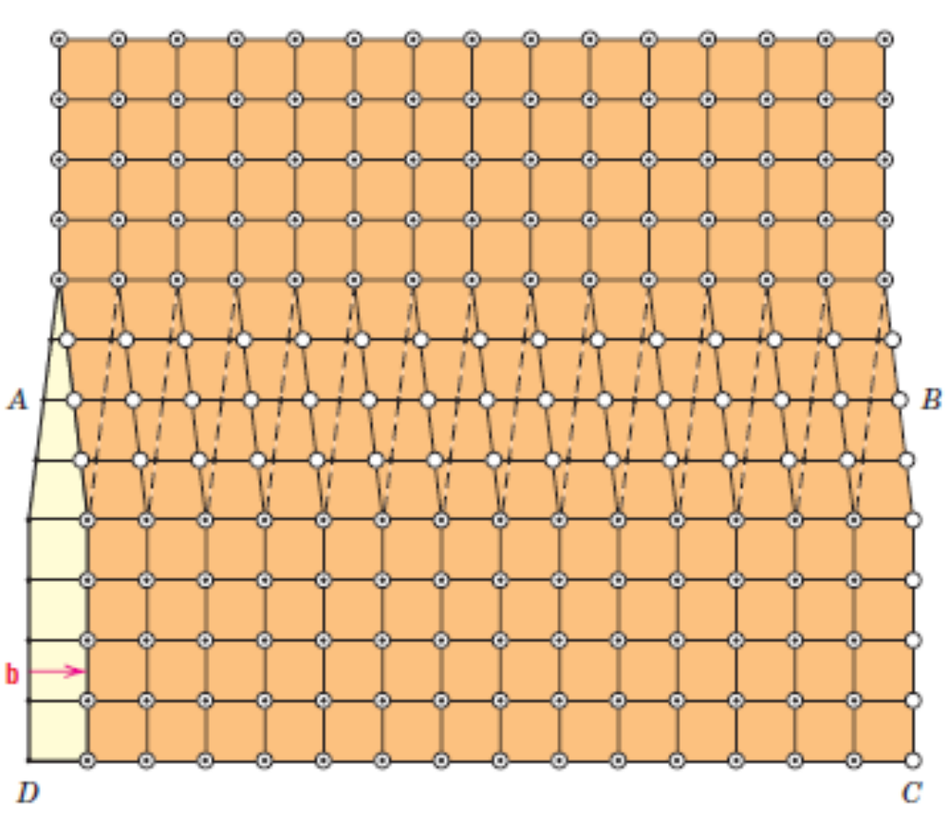
Line Defects – Screw Dislocation

Slide 13
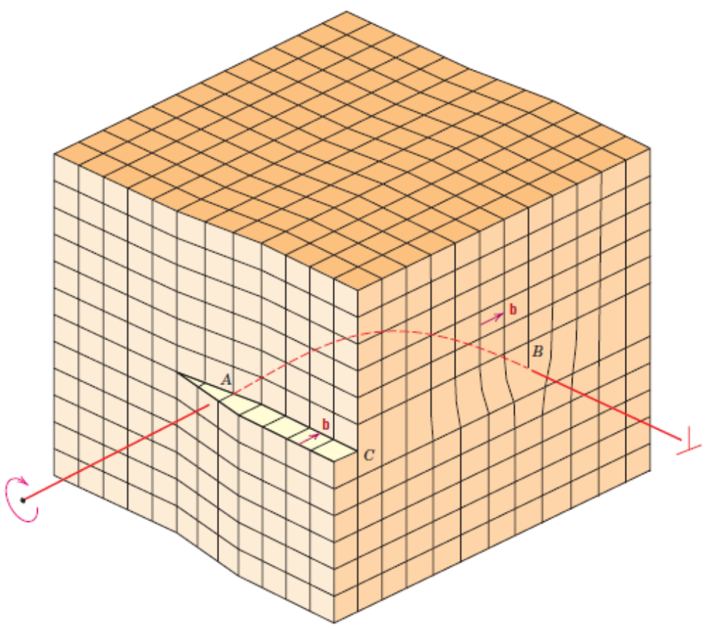
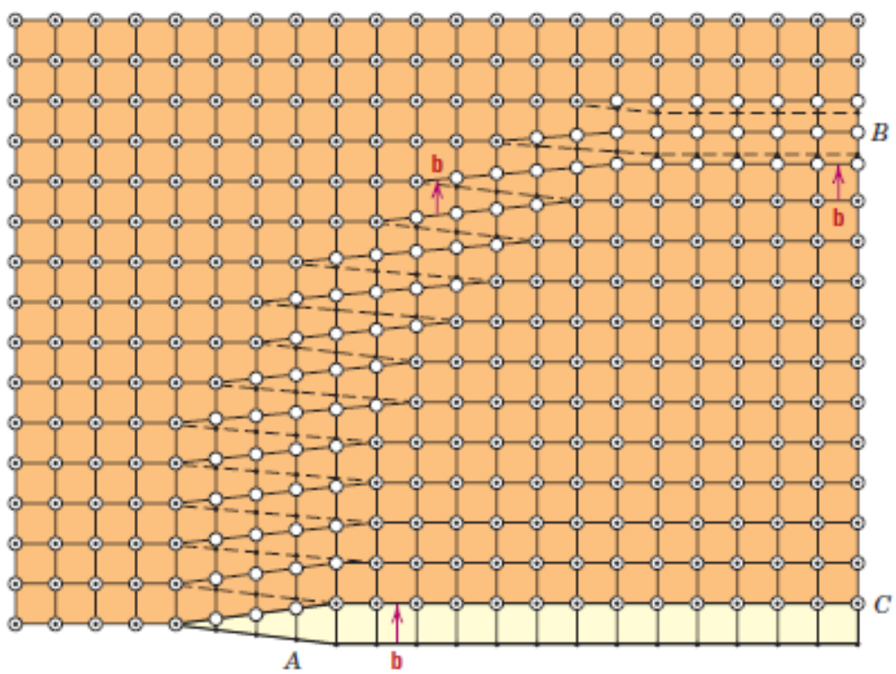
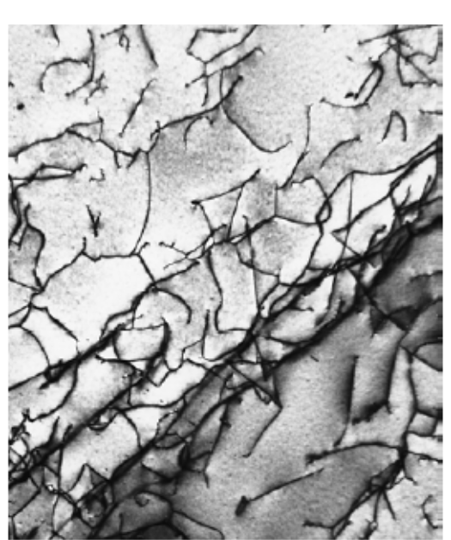
Line Defects – Mixed Dislocation
Transmission Electron Microscopic Image of a Ti alloy

Slide 14
Interfacial Defects – External Surfaces
Every object terminates at some point and hence, has boundaries or surfaces.
External surfaces are themselves interfacial defects as they are deprived of some nearest neighbouring atoms, unlike in the case of interior ones.
As a result, surfaces have some surface energy (J/m²) associated with them. The surfaces tend to lower this energy by minimizing the surface area. Liquid droplets are spherical due to this reason. Solids, being rigid, cannot.

Slide 15
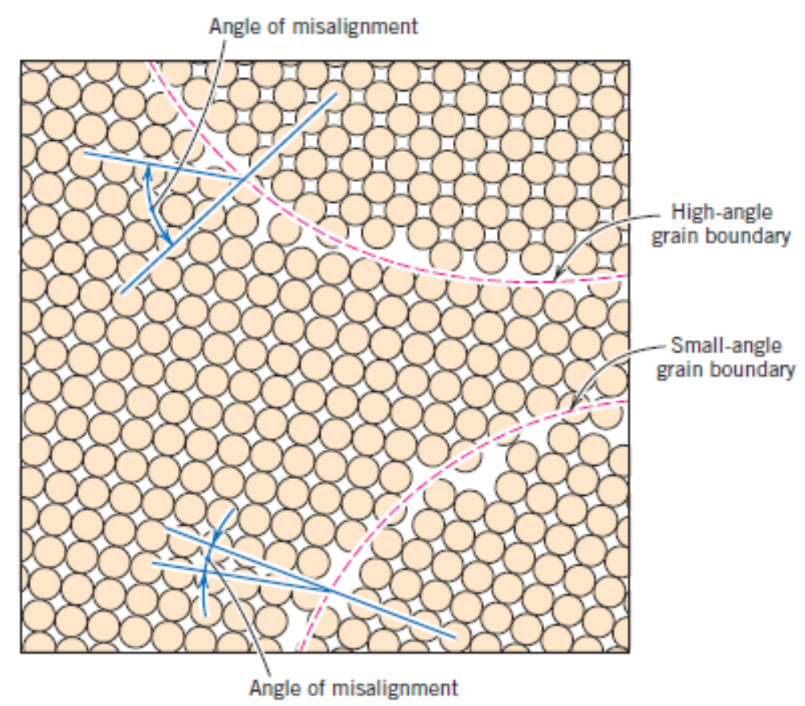
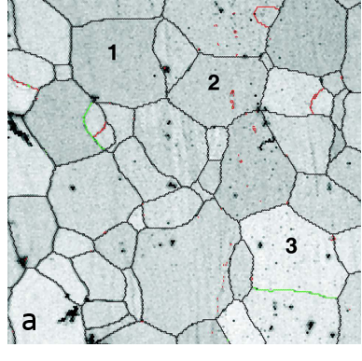
Interfacial Defects – Grain Boundaries
SEM Image of grain boundaries

Slide 16
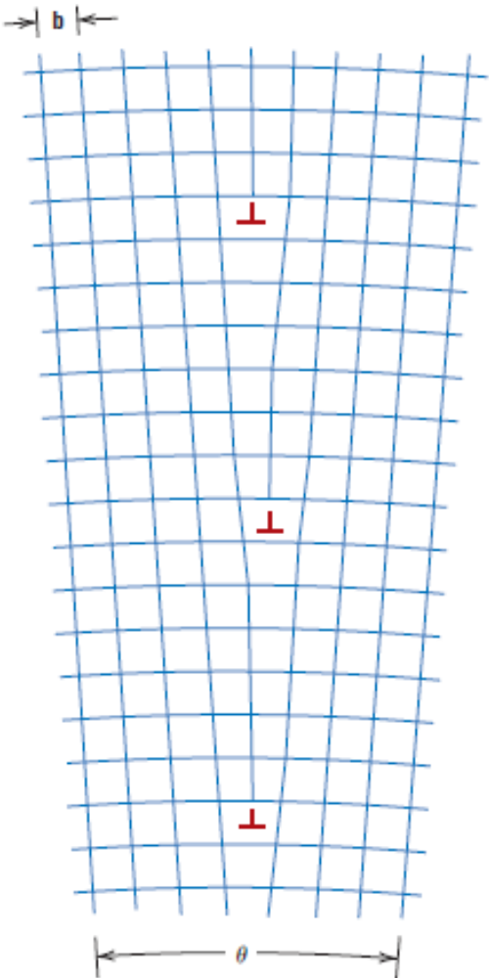
Interfacial Defects – Grain Boundaries
The adjacent figure shows a type of interfacial defect called tilt boundary.
A similar type of defect is twist boundary which can be described using screw type of dislocations.
The atoms along the grain boundaries are less regularly arranged.
Grain boundaries also are at a higher energy state. The magnitude of this energy is function of the degree of the misorientation.
Tilt boundary due to alignment of edge dislocations

Slide 17
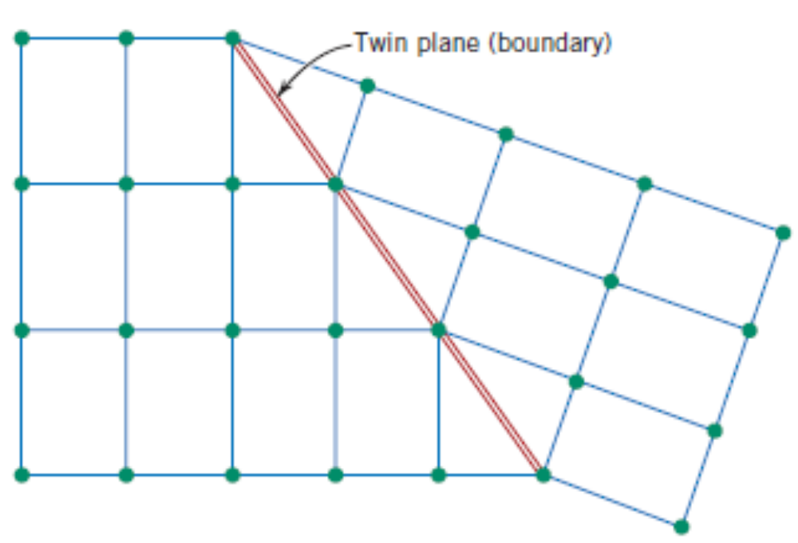
Interfacial Defects – Twin Boundaries

Slide 18
Interfacial Defects – Miscellaneous
A stacking fault – say, in FCC, a break in the sequence of stacking of {111} planes ABCABCABC…
Phase boundaries in multiphase materials.
Ferromagnetic domain walls
Bulk or Volume Defects
Pores, cracks, foreign inclusions and other phases.
Atomic vibrations
Atomic vibrations are also a kind of defect, especially at very high temperatures which affect the properties of a solid.

Slide 19
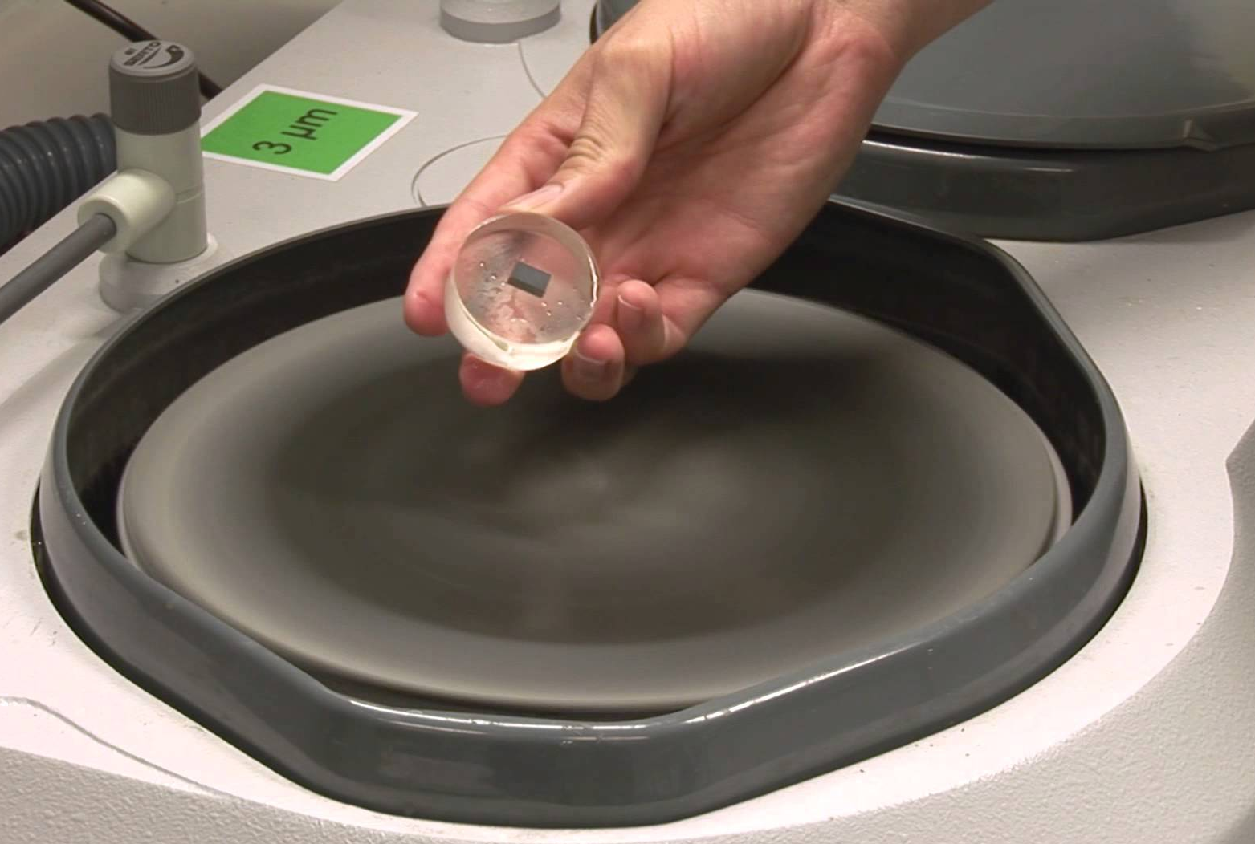
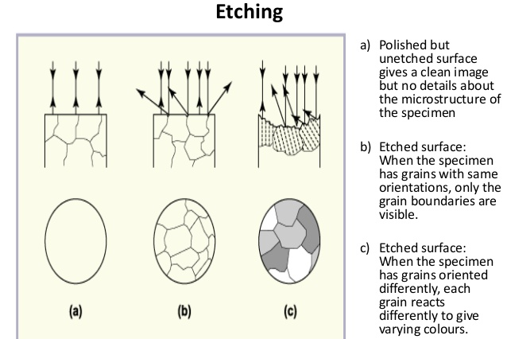
Microscopic Examination – Optical Microscopy
Metallographic microscopy – applicable to polymers also.
Surface preparation is very crucial. Surface must be ground and polished to a smooth and mirror like finish.
Following this, surface treatment using a chemical reagent to etch the grains is to be done.

Slide 20
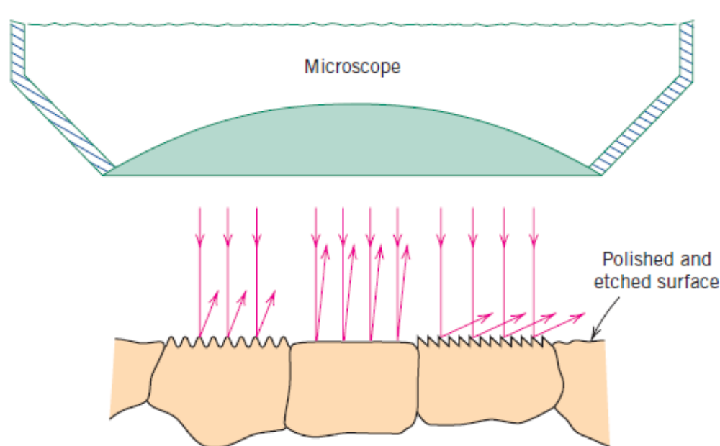
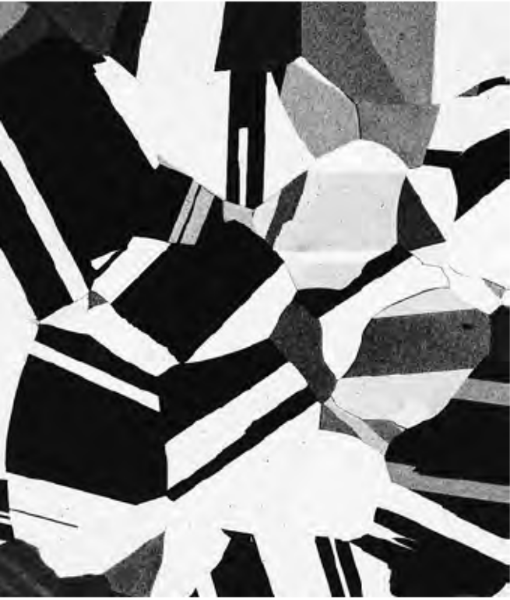
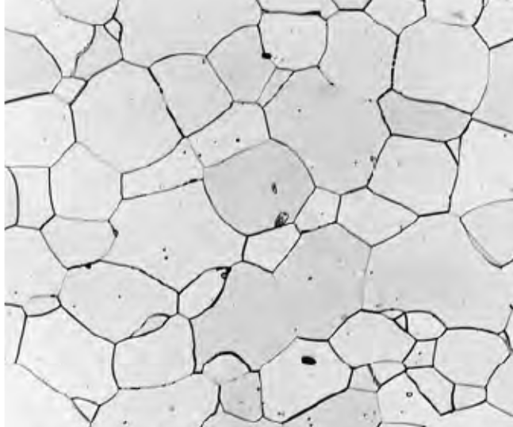
Microscopic Examination – Optical Microscopy
Iron–Chromium alloy 100X magnification
A schematic demonstrating optical microscopy
A optical micrograph of polycrystalline Brass
Magnification limits: 2000 X

Slide 21
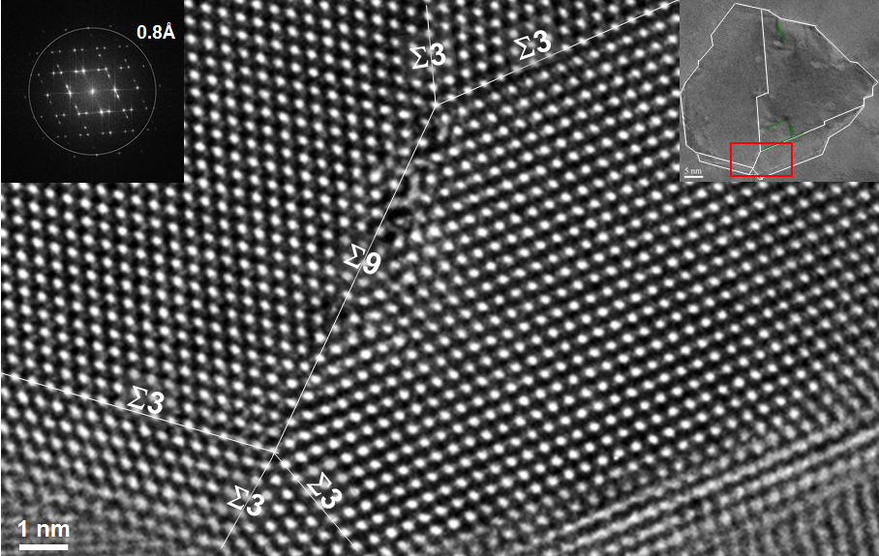
Microscopic Examination – Electron Microscopy
Electron beams are incident on the sample instead of light. Electron beams can have wavelengths in the order of picometers.
This gives a very good magnification of the sample under observation.
Transmission Electron Microscopy:
  Electron beam passes through the specimen.
  Specimens should be in the form of a thin foil so as to allow the incident beam to be transmitted.
  Transmitted beam is projected on to a fluorescent screen or a photographic film.
  Possible magnifications: 1000000 X
Atomic resolution TEM image of a triple and a quadruple line at the interface between Σ3 boundaries and a Σ9 boundary in nanocrystalline palladium.

Slide 22
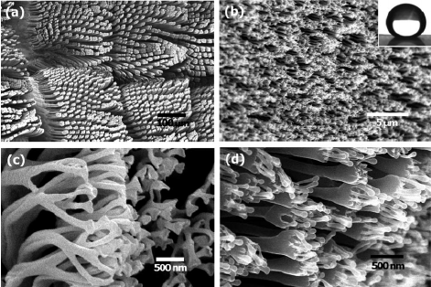
Microscopic Examination – Electron Microscopy
Scanning Electron Microscopy:
  The surface of the specimen is scanned and the reflected beam of electrons is collected to be displayed on a CRT (Cathode Ray Tube).
  Only surface features of the specimen can be viewed.
  The surface has to be electrically conductive.
  A very thin metallic surface coating is to be applied for non–conducting materials.
  Possible magnifications: 50000 X
Tokay Gecko

Slide 23
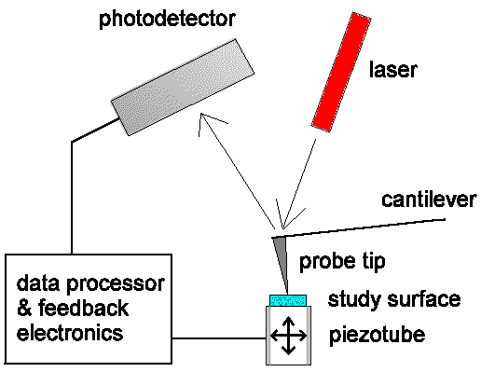
Microscopic Examination – Scanning Probe Microscopy
Based on the deflections of the tip of a probe that is being scanned over the surface of specimen.
Piezoelectric tips transfer these deflections into electronic signals, which upon deciphering using a computer renders 3–D surface images.

Slide 24
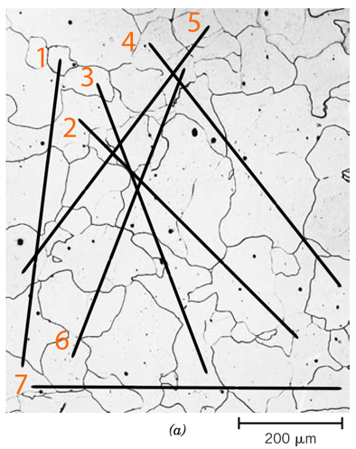
Grain size determination
Draw lines of equal length on the photomicrograph.
Count the number of grains intersected by each of these line segment and take an average.
Divide the line segment length with this average number.
Divide this grain size with the magnification of the micrograph.

Slide 25
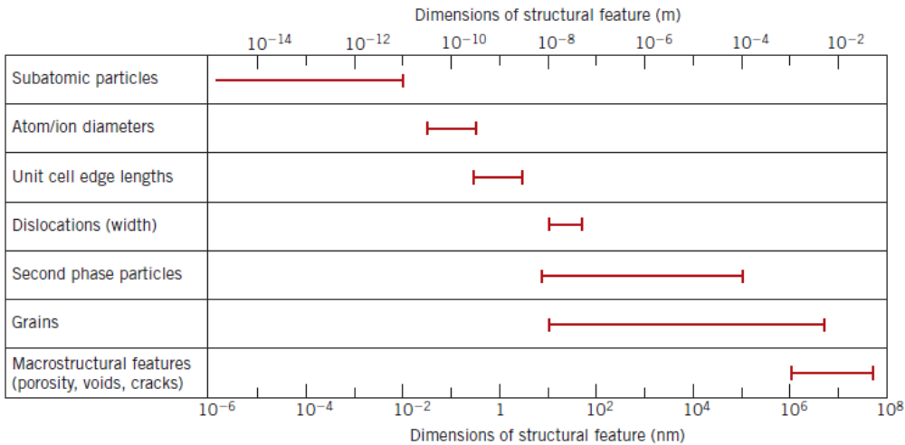
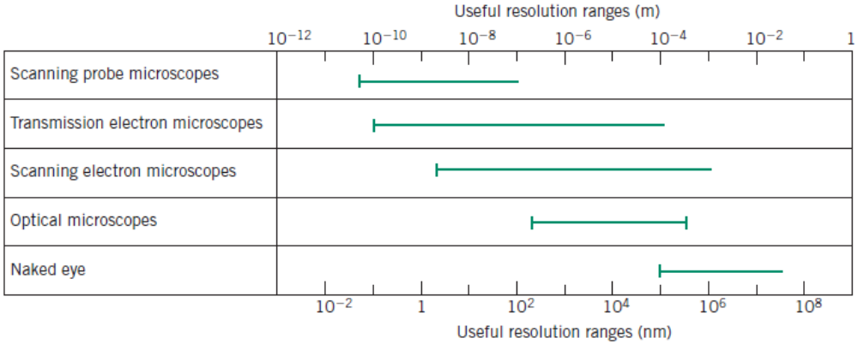
Microscopic Examination – Summary

